Slide 1
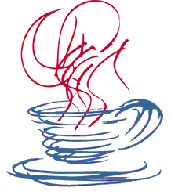
GUI Programming
with Java
Session 6
MVC

Slide 2
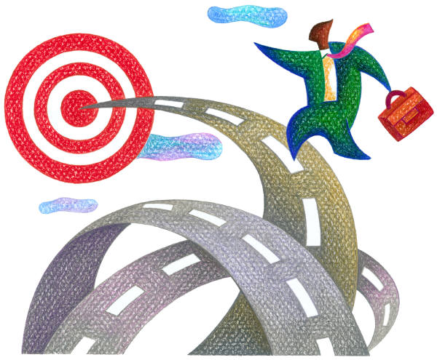
We will look at…
  MVC

Slide 3
The Model-View-Controller Architecture
The Model-View-Controller (MVC) design pattern was developed using the Smalltalk programming environment for the creation of user interfaces. It is a popular OO pattern
The goal of the MVC design pattern is to separate the application object (model) from the way it is represented to the user (view) from the way in which the user controls it (controller).
Before MVC, user interface designs tended to lump such objects together. MVC decouples them thus allowing greater flexibility and possibility for re-use. MVC also provides a powerful way to organise systems that support multiple presentations of the same information.

Slide 4
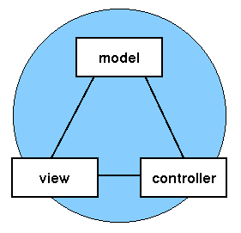
The Model-View-Controller Architecture

Slide 5
What is a design pattern?
One of the main reasons computer science researchers began to recognize design patterns was to satisfy the need for good, simple, and reusable solutions.
The term design pattern can sound a little bit formal to the beginner, but in fact a design pattern is just a convenient way of reusing object-oriented code between projects and between programmers.
The idea behind design patterns is simple:
To catalog common characteristics between objects that programmers have often found useful.

Slide 6
What is a design pattern?
Some useful definitions of design patterns have emerged as the literature in this field has expanded:
  “Design patterns are recurring solutions to design problems you see over and over.” [Smalltalk Companion]
  “Design patterns focus on the reuse of architectural design themes.” [Coplien and Schmidt, 1995]
  “A pattern addresses a recurring design problem that arises in specific design situations and presents a solution to it.” [Buschmann and Meunier, et al., 1996]
  “Patterns identify and specify abstractions that are above the level of single classes and instances, or of components.” [Gamma, Helm, Johnson, and Vlissides, 1993]

Slide 7
How is MVC a design pattern?
In MVC, each aspect of the problem is a separate object, and each has its own rules for managing its data.
Communication between the user, the graphical user interface, and the data should be carefully controlled; this separation of functions accomplishes that.
Three objects talking to each other using this restrained set of connections is an example of a powerful design pattern.
This architecture follows the goals of a design pattern, which describes how objects communicate without becoming entangled in each other’s data models and methods.

Slide 8
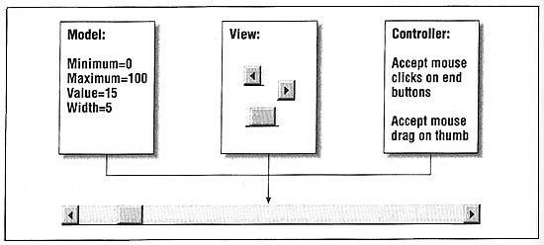
MVC Example

Slide 9
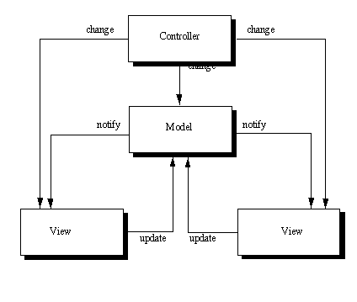
The Model-View-Controller Architecture

Slide 10
The Model
The model object knows about all the data that need to be displayed.
It also knows about all the operations that can be applied to transform that object.
However, it knows nothing whatever about the GUI, the manner in which the data are to be displayed, nor the GUI actions that are used to manipulate the data.
The data are accessed and manipulated through methods that are independent of the GUI.

Slide 11
The Model (2)
A simple example of a model would be a clock object.
  It has intrinsic behavior whereby it keeps track of time by updating an internal record of the time ever second.
  The object would provide methods which allow view objects to query the current time.
  It would also provide methods to allow a controller object to set the current time.

Slide 12
The View Object
The view object refers to the model.
It uses the query methods of the model to obtain data from the model and then displays the information.
The display can take any form
  in the clock example, one view object could display the time as an analogue clock
  another could show it as a digital clock
The different displays would have no bearing whatsoever on the intrinsic behavior of the clock.

Slide 13
The Controller Object
The controller object knows about the physical means by which users manipulate data within the model.
In a GUI for example, the controller object would receive mouse clicks or keyboard input which it would translate into the manipulator method which the model understands.
For example, the clock could be reset directly by typing the current time into the digital clock display.
The controller object associated with the view would know that a new time had been entered and would call the relevant "SetTime" method for the model object.

Slide 14
MVC Example

Slide 15
MVC Example (2)
Model
  Represents the state of the component
  Data is independant of the component's visual representation
View
  How the component is represented on the screen (LnFs)
Controller
  Describes how the component interacts with the user
The scrollbar uses the information in the model to determine how far into the scrollbar to render the thumb and how wide the thumb should be.

Slide 16
Advantages of the Model-View-Controller Architecture (1)
The MVC architecture has the following benefits:
1) Multiple views using the same model: The separation of model and view allows multiple views to use the same enterprise model. Consequently, an enterprise application's model components are easier to implement, test, and maintain, since all access to the model goes through these components.
2) Easier support for new types of clients: To support a new type of client, you simply write a view and controller for it and wire them into the existing enterprise model.

Slide 17
Advantages of the Model-View-Controller Architecture (2)
3) Clarity of design: By glancing at the model's public method list, it should be easy to understand how to control the model's behavior. When designing the application, this trait makes the entire program easier to implement and maintain.
4) Efficient modularity: of the design allows any of the components to be swapped in and out as the user or programmer desires - even the model! Changes to one aspect of the program aren't coupled to other aspects, eliminating many nasty debugging situations. Also, development of the various components can progress in parallel, once the interface between the components is clearly defined.

Slide 18
Advantages of the Model-View-Controller Architecture (3)
5) Ease of growth: Controllers and views can grow as the model grows; and older versions of the views and controllers can still be used as long as a common interface is maintained.
6) Distributable: With a couple of proxies one can easily distribute any MVC application by only altering the startup method of the application.

Slide 19
How does MVC fit in with our study of SWING?
When the JAVA development team where putting together SWING they had five basic development goals
  Be implemented entirely in Java to promote cross-platform consistency and easier maintenance.
  Provide a single API capable of supporting multiple look-and-feels so that developers and end-users would not be locked into a single look-and-feel.
  Enable the power of model-driven programming without requiring it in the highest-level API.
  Adhere to JavaBeansTM design principles to ensure that components behave well in IDEs and builder tools.
  Provide compatibility with AWT APIs where there is overlapping, to leverage the AWT knowledge base and ease porting.

Slide 20
How does MVC fit in with our study of SWING?
Early on, MVC was a logical choice for Swing because it provided a basis for meeting the first three of the teams design goals within the bounds of the latter two.
It was quickly discovered that this split didn't work well in practical terms because the view and controller parts of a component required a tight coupling (for example, it was very difficult to write a generic controller that didn't know specifics about the view).
The development team then collapsed these two entities into a single UI (user-interface) object, as shown in the following diagram:

Slide 21
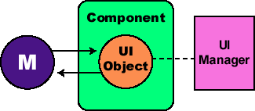
The UI delegate object shown in this picture is sometimes called a delegate object, or UI delegate.
As the diagram illustrates, Swing architecture is loosely based -- but not strictly based -- on the traditional MVC design.
In the world of Swing, this new quasi-MVC design is sometimes referred to a separable model architecture.
Swing's separable model design treats the model part of a component as a separate element, just as the MVC design does. But Swing collapses the view and controller parts of each component into a single UI (user-interface) object.
How does MVC fit in with our study of
SWING?
Lecture4: MVC and Design Patterns Slide

Slide 22
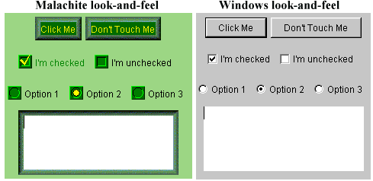
Pluggable Look and Feel?
One of the major advantages MVC architecture provides is the ability to customize the "look" and "feel"of a component without modifying the model.
The graphic shows a group of components using two different user interfaces.

Slide 23
Pluggable Look and Feel?
The important point to make about this figure is that the components shown are actually the same, but they are shown using two different look-and-feel implementations.
Swing includes several sets of UI delegates. Each set contains ComponentUI implementations for most Swing components and we call each of these sets a look-and-feel or a pluggable look-and-feel (PLAF) implementation.
The javax.swing.plaf package consists of abstract classes derived from ComponentUI, and the classes in the javax.swing.plaf.basic package extend these abstract classes to implement the Basic look-and-feel (our standard appearance for buttons etc).

Slide 24
Pluggable Look and Feel?
This is the set of UI delegates that all other look-and-feel classes are expected to use as a base for building off of.
There are three pluggable look-and-feel implementations derived from the Basic look-and-feel:
  Windows:
  com.sun.java.swing.plaf.windows.WindowsLookAndFeel
  CDE\Motif:
  com.sun.java.swing.plaf.motif.MotifLookAndFeel
  Metal (default):
  javax.swing.plaf.metal.MetalLookAndFeel

Slide 25
Pluggable Look and Feel?
There is also a MacLookAndFeel for simulating Macintosh user interfaces, but this does not ship with Java 2 and must be downloaded separately.
The Windows and Macintosh pluggable look-and-feel libraries are only supported on the corresponding platform.
To change the current look-and-feel of an application we can simply call the UIManager’s setLookAndFeel() method, passing it the fully qualified name of the LookAndFeel to use.

Slide 26
Pluggable Look and Feel?
try { UIManager.setLookAndFeel( "com.sun.java.swing.plaf.motif.MotifLookAndFeel"); SwingUtilities.updateComponentTreeUI(myJFrame);
}
catch (Exception e) { System.err.println("Could not load LookAndFeel");
}

Slide 27
Lab Exercises for Lecture 6
Go through Lecture 6 and answer the following questions in your own words:
Explain the goal of the MVC design pattern.
What is a design pattern?
Illustrate using a diagram the MVC design pattern
Explain each of the components of the MVC (Slide 15 and other slides).
Provide two examples of the MVC
  Min/Max data
  Clock Timer
List six advantages of the MVC?
Swing introduced UIs to the traditional MVC – explain this modification referring to Look and Feels (LnFs)

